Slide 1

GRAND CANYON UNIFIED SCHOOL DISTRICT
MASTER DRAINAGE PLAN
NORTHERN ARIZONA UNIVERSITY
CENE 486C – CAPSTONE PROJECT
Instructor: Mark Lamer, P.E.
Technical Advisor: Jeffrey Heiderscheidt, Ph.D.
Client: Ivan Landry
Sulaiman Alhabashi
Ahmed Alsahili
Sean Heckmann
Jason MacDonald
December 7, 2018

Slide 2
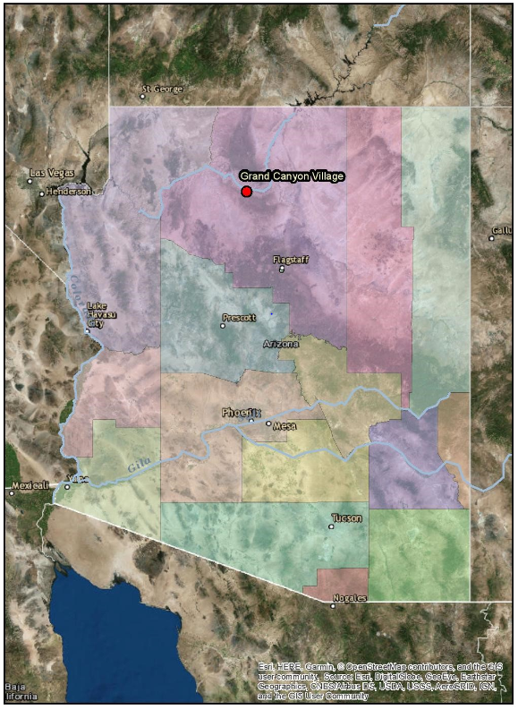
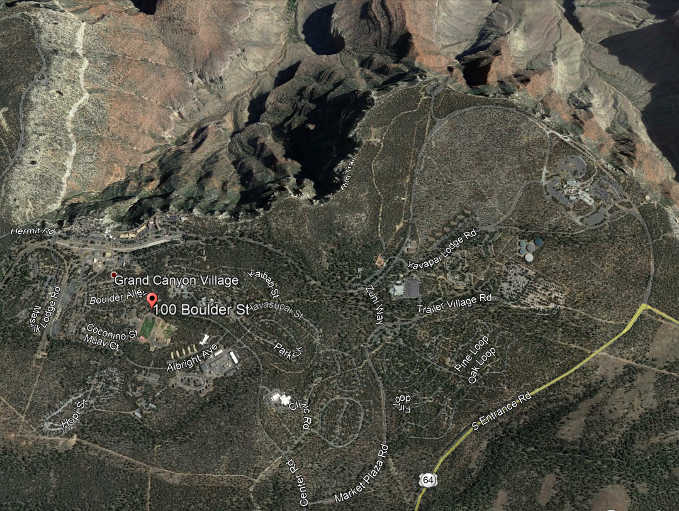

INTRODUCTION
Figure 1: State map of GCUSD site [1]
Figure 2: Regional map of GCUSD site [2]
  Project goal:
    Evaluate site hydrology
    Assess performance of existing infrastructure
    Propose alternative options for problematic areas and items to convey water off the property

Slide 3
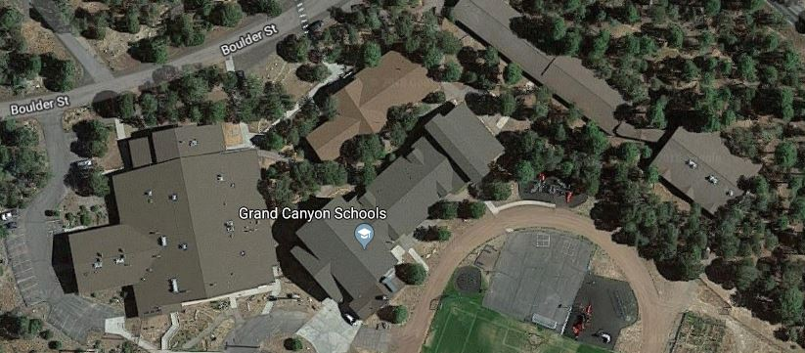
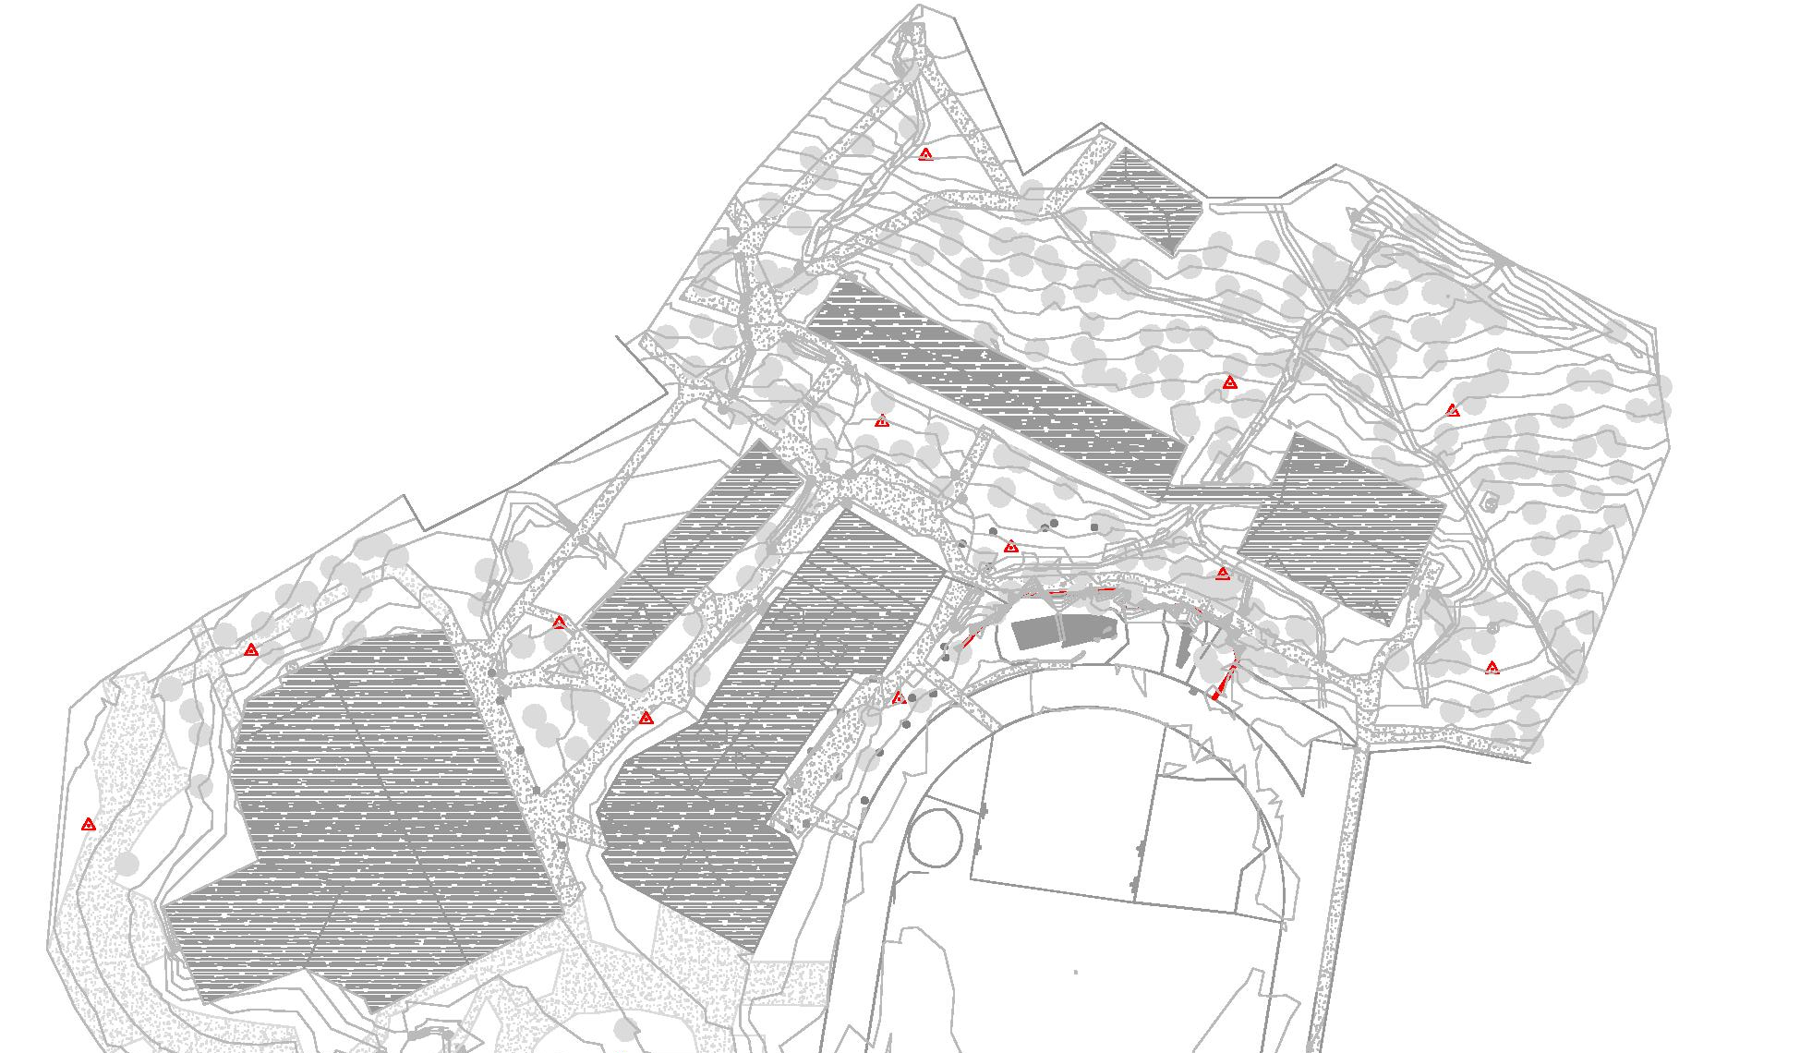
INTRODUCTION
Figure 3: Aerial view of GCUSD campus [2]
Problem
Area C
Problem
Area A
Problem
Area E
Problem
Area D
Problem
Area C
Problem
Area B
Problem
Area A
Problem
Area E
Problem
Area D
Problem
Area B
Figure 4: Topographic map of GCUSD campus [3]

Slide 4
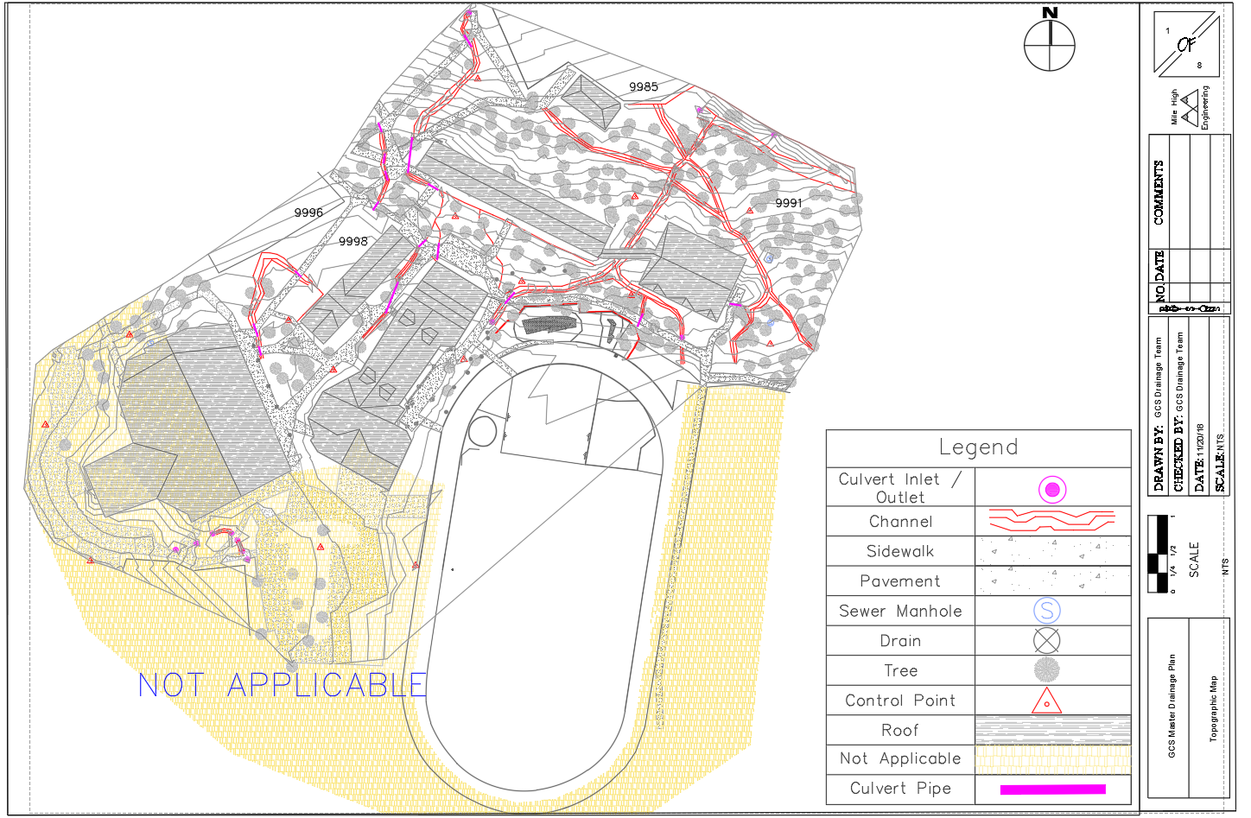
SURVEY RESULTS
Contours : 1 Ft
Figure 5: Topographic site map with culverts, channels, and impervious area identified. [3]

Slide 5
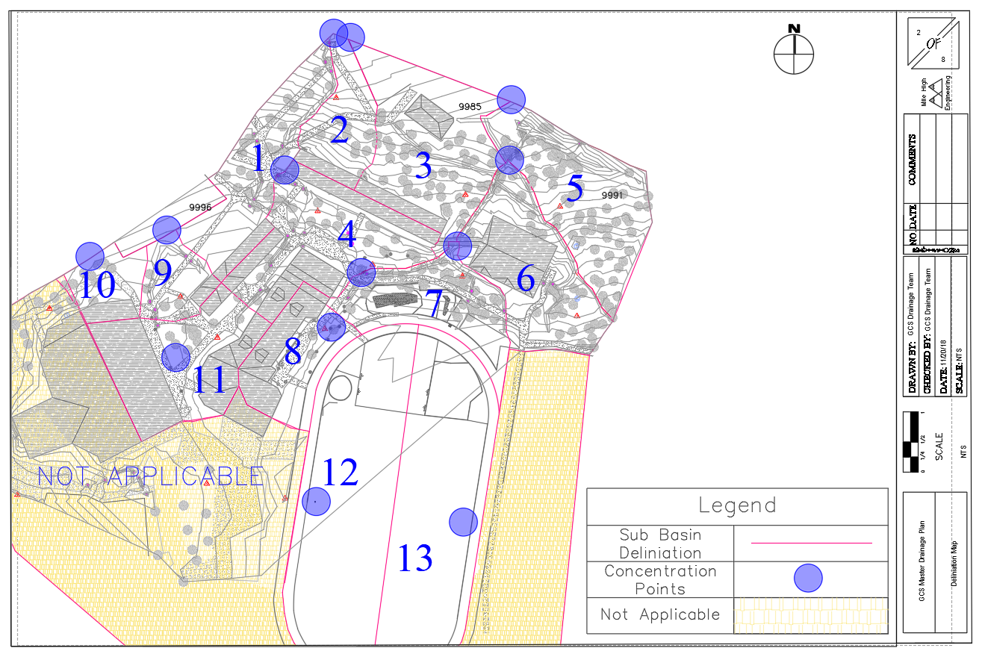
SUB BASIN
DELINEATION
Table 1: Areas of Sub Basins
GCUSD Sub Basin Delineation Information
# | Area (ft²) | Area (Acres)
1 | 20872.3 | 0.5
2 | 11590.6 | 0.3
3 | 22974.8 | 0.5
4 | 27568.2 | 0.6
5 | 26793.6 | 0.6
6 | 25263.2 | 0.6
7 | 19199.7 | 0.4
8 | 15385.3 | 0.4
9 | 7915.2 | 0.2
10 | 7864.6 | 0.2
11 | 25224.3 | 0.6
12 | 39688.8 | 0.9
13 | 41448.9 | 1.0
Total | 291789 | 6.7
Contours : 1 Ft
Figure 6: Watershed delineation of GCUSD campus with concentration points. [3]

Slide 6

RATIONAL METHOD
Table 2: Weighted coefficients for GCUSD campus sub basins.
Weighted Runoff Coefficients
Sub-Basin | C_{w}
1 | 0.345
2 | 0.364
3 | 0.338
4 | 0.574
5 | 0.145
6 | 0.444
7 | 0.302
8 | 0.618
9 | 0.339
10 | 0.401
11 | 0.760
12 | 0.113
13 | 0.112
Table 3: Summary of parameters used for hydrological analysis.
Hydrological Parameters
Factor | Variable | Average Recurrence Interval
 |  | 25 Years | 50 Years
Antecedent Precipitation Factor | C_{f} | 1.1 | 1.2
Rainfall Intensity (10 min) | I | 1.16 in | 1.43 in
[4]
[5]
Equation 1: Modified Rational Method [4]
$$Q=C_{f}∗C_{w}∗I∗A$$
Where Q = Volumetric Discharge (cfs)
C_{f} = Antecedent Precipitation Factor
C_{w} = Weighted Runoff Coefficient
I = Rainfall Intensity (in/hr)
A = Sub-Basin Area (acres)

Slide 7
HYDROLOGY
Table 4: Summary of sub-basin hydrology analysis.
Sub-Basin Hydrology Summary
Sub-Basin | A (acres) | C_{w} | Q (cfs)
 |  |  | 25yr | 50yr
1 | 0.5 | 0.35 | 0.8 | 1.0
2 | 0.3 | 0.36 | 0.4 | 0.6
3 | 0.5 | 0.34 | 0.8 | 1.1
4 | 0.6 | 0.57 | 1.7 | 2.2
5 | 0.6 | 0.15 | 0.4 | 0.5
6 | 0.6 | 0.44 | 1.2 | 1.6
7 | 0.4 | 0.3 | 0.6 | 0.8
8 | 0.4 | 0.62 | 1 | 1.3
9 | 0.2 | 0.34 | 0.3 | 0.4
10 | 0.2 | 0.4 | 0.3 | 0.4
11 | 0.6 | 0.76 | 2 | 2.7
12 | 1.2 | 0.35 | 1.9 | 2.5
13 | 1.1 | 0.38 | 1.9 | 2.5
Problem
Area E
Problem
Area D
Problem
Area C
Problem
Area B
Problem
Area A
Table 5: Summary of problem area hydrology analysis.
Problem Area | Total Q (cfs)
 | 25 yr | 50 yr
A | 6.6 | 8.8
B | 5.4 | 7.2
C | 2.9 | 3.9
D | 2.0 | 2.7
E | 2.6 | 3.5
Figure 7: Problem area location with sub-basin data. [3]

Slide 8
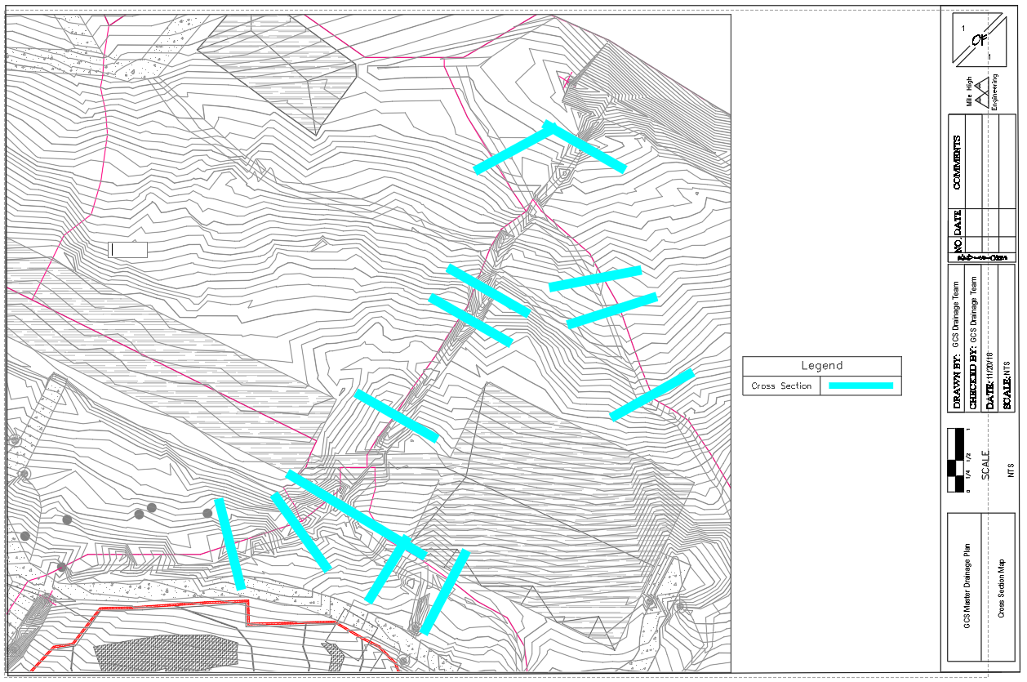
PROBLEM AREA
CROSS SECTIONS
Figure 8: Location of cross sections for Problem Area A and B. [3]

Slide 9
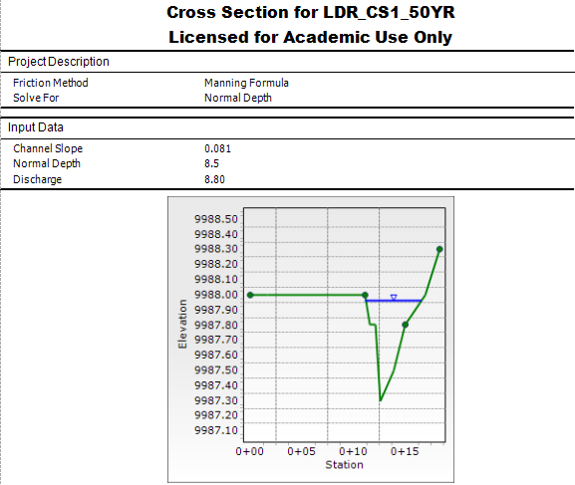
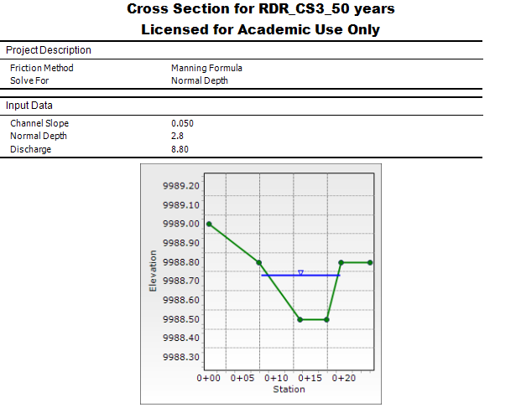
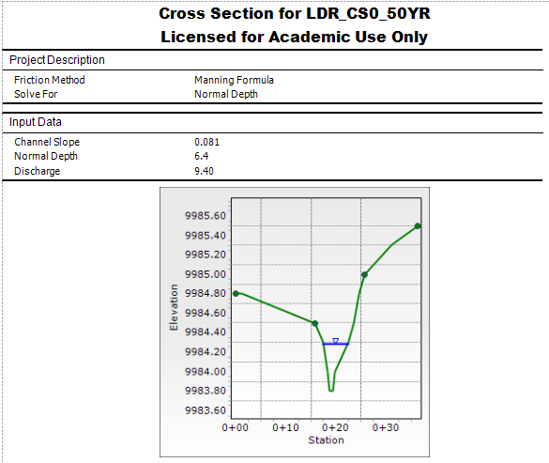
EXISTING CHANNEL
HYDRAULICS
Figure 9: FlowMaster cross section for left upstream of Problem Area A channel 50 year recurrence [6]
Figure 10: FlowMaster cross section for right upstream of Problem Area A channel [6]
Table 6: Summary of the results of problem Area A cross sections
Cross Section | Velocity (ft/s) | Flow Type | Depth to Floodplain (ft)
Left-hand channel | 5.20 | Supercritical | 0.05
Right-hand channel | 4.83 | Supercritical | 0.08
Combined section | 7.63 | Supercritical | 0.2
Figure 11: FlowMaster cross section for the combined downstream section of Problem Area A channel 50 year recurrence [6]

Slide 10
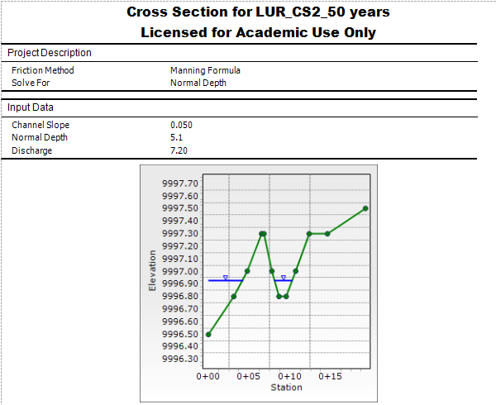
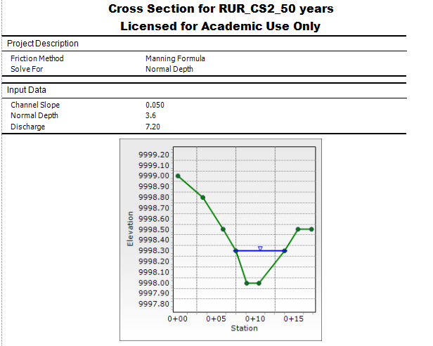
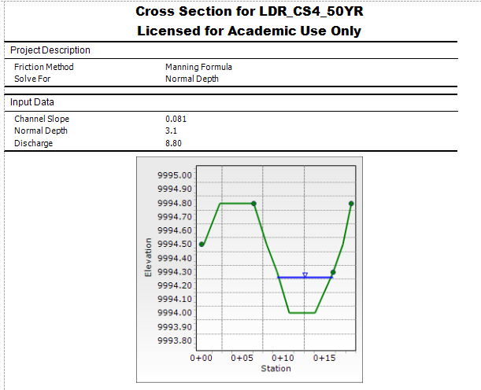
EXISTING CHANNEL
HYDRAULICS
Figure 12: FlowMaster cross section for left upstream of Problem Area B channel 50 year recurrence [6]
Figure 13: FlowMaster cross section for right upstream of Problem Area B channel [6]
Table 7: Summary of the results of problem Area B cross sections
Cross Section | Velocity (ft/s) | Flow Type | Depth to Floodplain (ft)
Left-hand channel | 5.44 | Supercritical | 0.4
Right-hand channel | 5.45 | Supercritical | 0.2
Combined section | 6.81 | Supercritical | 0.5
Figure 14: FlowMaster cross section for the combined downstream section of Problem Area B channel 50 year recurrence [6]

Slide 11
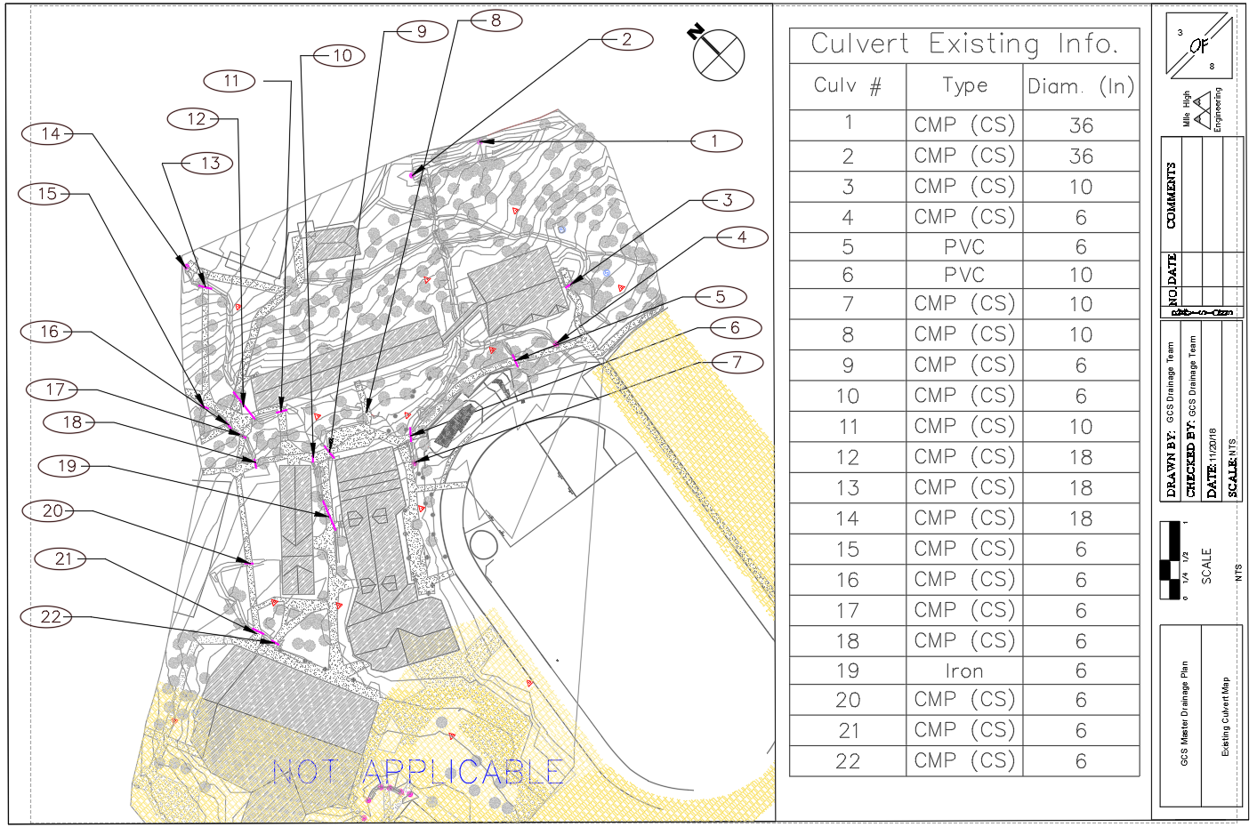
EXISTING CULVERTS
Figure 15: Location and inventory of existing culverts. [3]

Slide 12

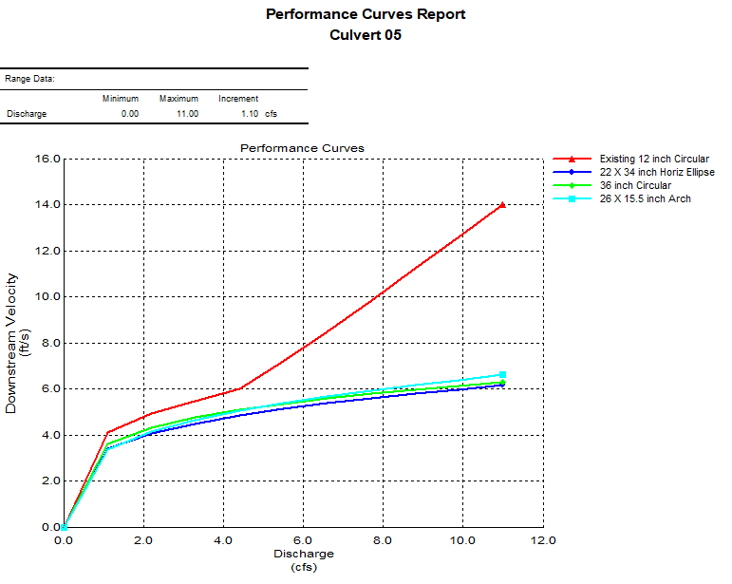
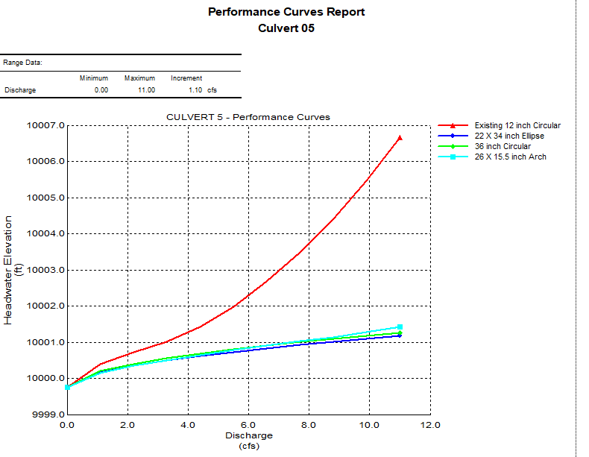
EXISTING CULVERTS
Table 8: Parameters for hydraulic analysis of existing and proposed culverts.
Maximum Headwater Elevation: | 1 foot above Upstream Invert Elevation
Maximum Height of Culvert: | 2 feet
Minimum Velocity in Culvert: | 3 feet/sec [4]
Maximum Velocity in Culvert: | 15 feet/sec [4]
Allowable Velocity in Channel: | 5 feet/sec [4]
25 year Discharge: | 5.38 ft³/sec
50 year Discharge: | 7.20 ft³/sec
Figure 16: Downstream velocity performance curves for Culvert 5. [7]
Figure 17: Headwater elevation performance curves for Culvert 5. [7]

Slide 13
EXISTING CULVERTS
Table 9: Summary of Existing Culvert Analysis
Existing Condition Analysis
Culvert | Elevation Above Crown | Downstream velocity | Notes | Pass/Fail
(#) | (ft) | (ft/s)
1 |  |  |  | n/a
2 |  |  |  | n/a
3 | 2.56 | 8.43 |  | FAIL
4 |  |  |  | n/a
5 | 2.1 | 9.22 |  | FAIL
6 | 1.17 | 7.05 |  | FAIL
7 |  |  |  | n/a
8 | 1.80 | 7.05 |  | FAIL
9 | 0.61 | 5.2 | **Actual diameter 6 inches | FAIL
10 | 0.13 | 4.51 | **Actual diameter 6 inches | FAIL
11 | -0.14 | 3.84 | **Actual diameter 10 inches | PASS
12 | -0.16 | 4.80 |  | PASS
13 | -0.17 | 4.80 |  | PASS
14 |  |  |  | n/a
15 | 0.13 | 4.51 | **Actual diameter 6 inches | FAIL
16 | 0.13 | 4.51 | **Actual diameter 6 inches | FAIL
17 | 0.27 | 4.51 | **Actual diameter 6 inches | FAIL
18 | 0.07 | 5.09 | **Actual diameter 6 inches | FAIL
19 | 0.07 | 5.28 | **Actual diameter 6 inches | FAIL
20 | 0.71 | 5.2 | **Actual diameter 6 inches | FAIL
21 | 0.05 | 4.04 | **Actual diameter 6 inches | FAIL
22 | 0.05 | 4.04 | **Actual diameter 6 inches | FAIL

Slide 14
PROPOSED CULVERTS
Table 10: Summary of proposed culvert design
Proposed Culvert Design
Culvert ID | Entrance | Slope (%) | Shape | Material | Size | Number | Length (Ft)
1 | Insufficient field data.
2 | Insufficient field data.
3 | Beveled ring, 33.7° (1.5:1)bevels | 1 | Circular | CMP | 18 inch | 2 | 12
4 | Insufficient field data.
5 | Groove end projecting (horizontal ellipse) | 1 | Horizontal Ellipse | Concrete | 22x34 inch | 1 | 14
6 | Groove end projecting (horizontal ellipse) | 1 | Horizontal Ellipse | Concrete | 22x34 inch | 1 | 20
7 | Insufficient field data.
8 | Groove end projecting (horizontal ellipse) | 1 | Horizontal Ellipse | Concrete | 22x34 inch | 1 | 14
9 | Groove end projecting (horizontal ellipse) | 1 | Horizontal Ellipse | Concrete | 14x23 inch | 1 | 15
10 | Groove end projecting (horizontal ellipse) | 1 | Horizontal Ellipse | Concrete | 14x23 inch | 1 | 10
11 | No Improvement Required
12 | No Improvement Required
13 | No Improvement Required
14 | Insufficient field data.
15 | Groove end projecting (horizontal ellipse) | 1 | Horizontal Ellipse | Concrete | 14x23 inch | 1 | 10
16 | Groove end projecting (horizontal ellipse) | 1 | Horizontal Ellipse | Concrete | 14x23 inch | 1 | 10
17 | Groove end projecting (horizontal ellipse) | 1 | Horizontal Ellipse | Concrete | 14x23 inch | 1 | 10
18 | Groove end projecting (horizontal ellipse) | 1 | Horizontal Ellipse | Concrete | 14x23 inch | 1 | 10
19 | Beveled ring, 33.7° bevels | 1 | Circular | Corrugated HDPE (Smooth Interior) | 12 inch | 2 | 35
20 | Groove end projecting (horizontal ellipse) | 1 | Horizontal Ellipse | Concrete | 14x23 inch | 1 | 10
21 | Beveled ring, 33.7° bevels | 1 | Circular | Corrugated HDPE (Smooth Interior) | 15 inch | 1 | 12
22 | Beveled ring, 33.7° bevels | 1 | Circular | Corrugated HDPE (Smooth Interior) | 15 inch | 1 | 12
23 | Groove end projecting (horizontal ellipse) | 1 | Horizontal Ellipse | Concrete | 19x30 inch | 3 | 6
24 | 45° wingwall flares – offset | 1 | Box | Concrete | 4x4 feet | 1 | 10
25 | Groove end projecting (horizontal ellipse) | 1 | Horizontal Ellipse | Concrete | 14x23 inch | 1 | 10

Slide 15
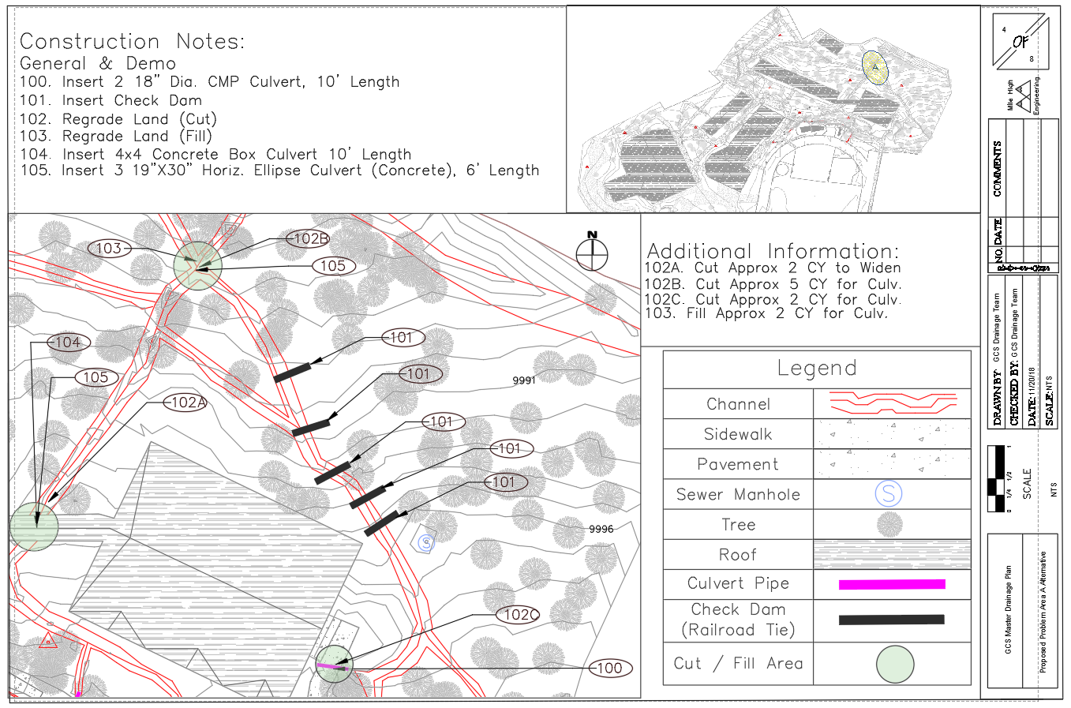
AREA A PROPOSAL
Figure 18: Proposed alternatives for Problem Area A with construction notes. [3]

Slide 16
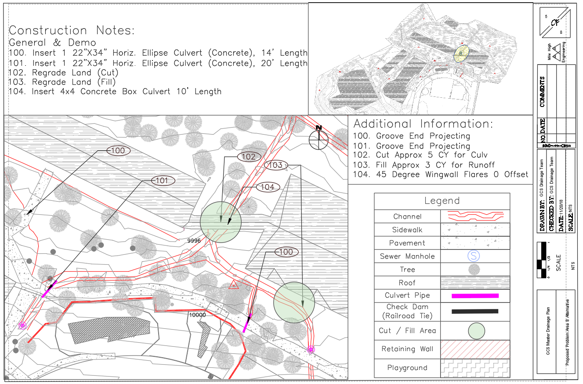
AREA B PROPOSAL
Figure 19: Proposed alternatives for Problem Area B with construction notes. [3]

Slide 17
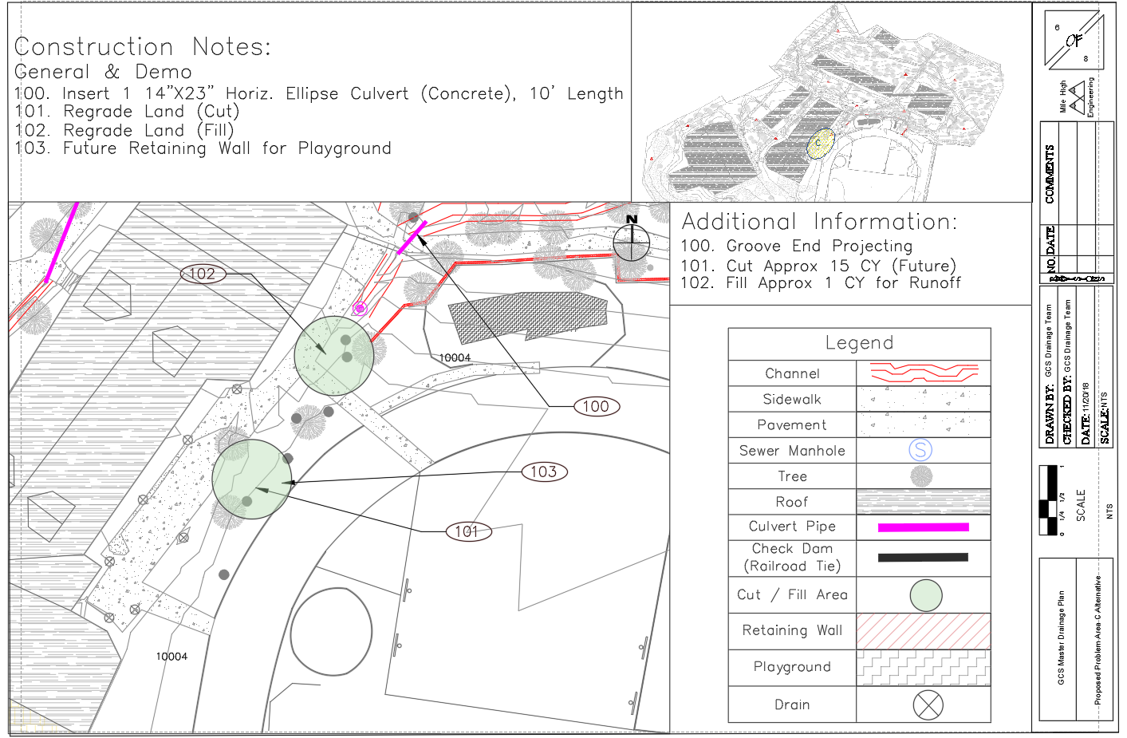
AREA C PROPOSAL
Figure 20: Proposed alternatives for Problem Area C with construction notes. [3]

Slide 18
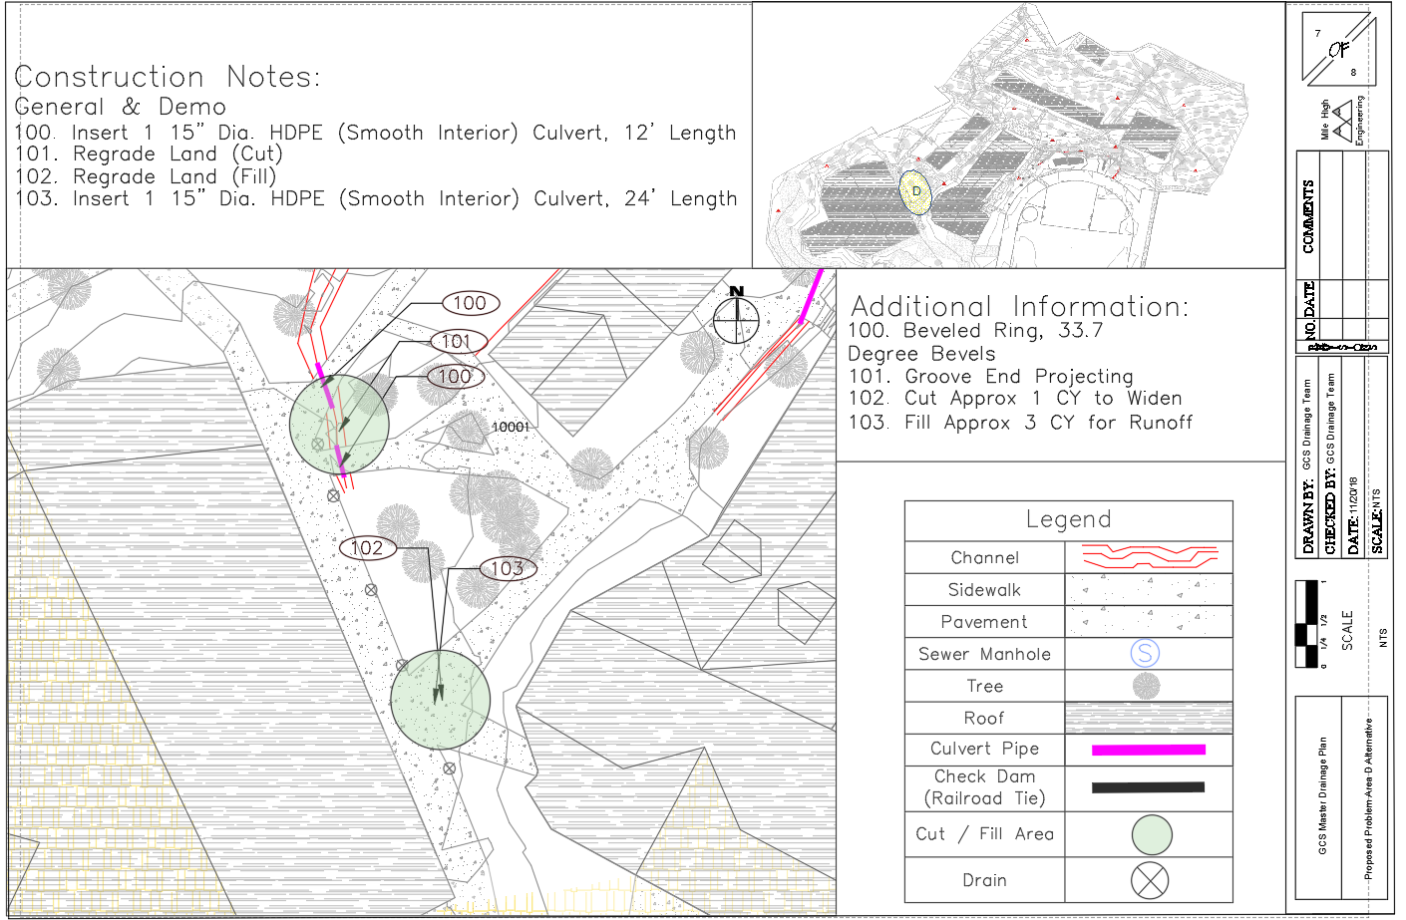
AREA D PROPOSAL
Figure 21: Proposed alternatives for Problem Area D with construction notes. [3]

Slide 19
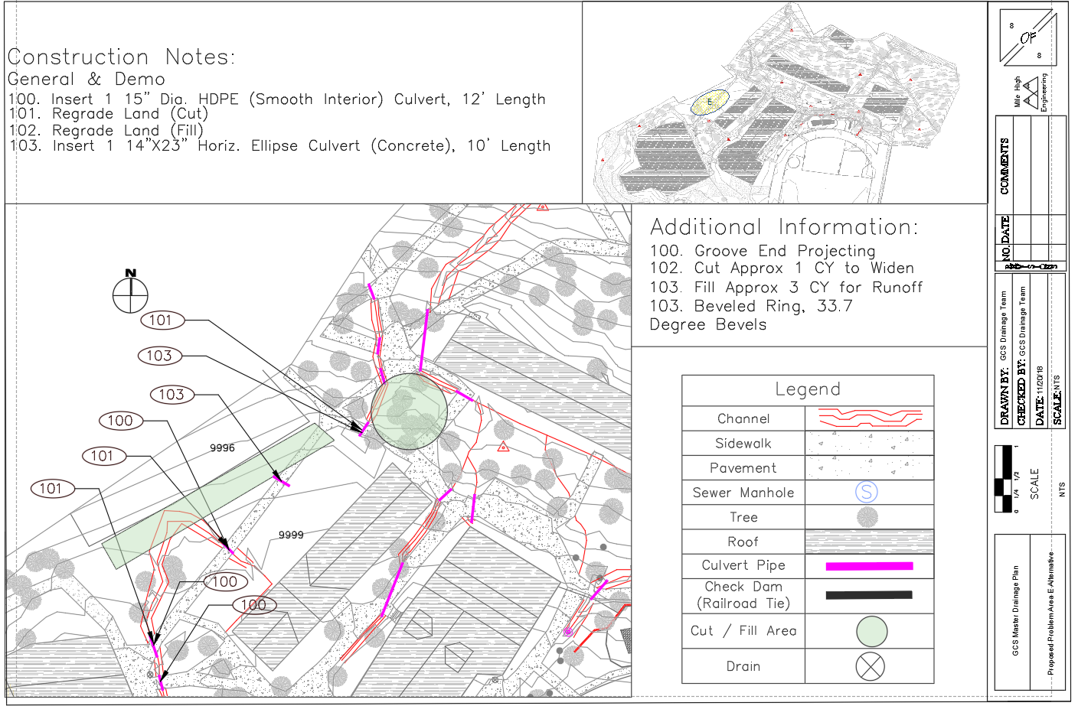
AREA E PROPOSAL
Figure 22: Proposed alternatives for Problem Area E with construction notes. [3]

Slide 20
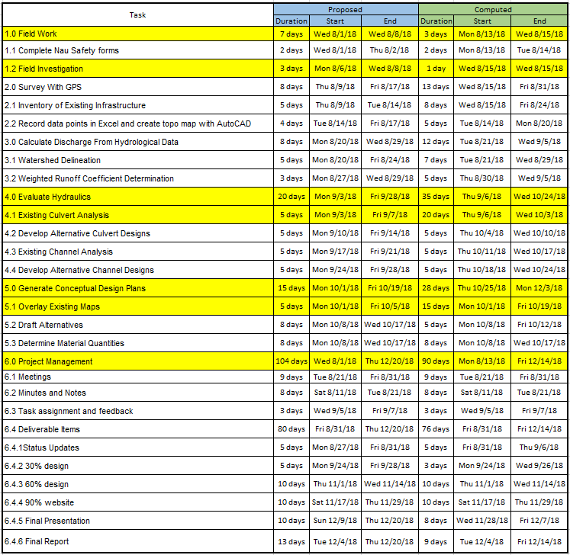
PROJECT SCHEDULE
Table 11: Proposed (CENE476) and Completed (CENE486) schedule

Slide 21
TASKS AND STAFFING
Table 12: MAJOR TASKS AND STAFF HOURS
Major Tasks and Staff Proposed & Actual (Hrs)
# | Task Description | Principle | Manager | PE | EIT | Tech | Admin | Proposed hours | Actual Hours
1.0 | Field Work | 1 | 1 | 3 | 8 | 0 | 1 | 32 | 14
2.0 | Surveying with GPS | 0 | 0 | 4 | 90 | 0 | 0 | 53 | 94
3.0 | Hydrology | 1 | 1 | 2 | 20 | 20 | 0 | 30 | 44
4.0 | Evaluate Hydraulics | 0 | 0 | 4 | 20 | 10 | 0 | 120 | 34
5.0 | Generate Conceptual Design Plans | 1 | 8 | 8 | 24 | 24 | 24 | 54 | 89
6.0 | Provide Documentation | 0 | 0 | 8 | 24 | 24 | 8 | 14 | 64
7.0 | Project Management | 40 | 80 | 40 | 120 | 120 | 80 | 400 | 480
Total Staff Hours |  | 43 | 90 | 69 | 306 | 198 | 113 | 703 | 819

Slide 22
COST OF SERVICES
Table 13: Staff and Rates for gcUsD master drainage project
Staff Member Rates and Hours
Position | Rate ($/hr) | Proposed |  | Actual
 |  | (hrs) | (USD) | (hrs) | (USD)
Principal Engineer | 200 | 57 | 11,400 | 43 | 8,600
Manager | 125 | 45 | 5,625 | 90 | 11,250
Project Engineer | 142 | 96 | 13,632 | 69 | 9798
EIT | 105 | 201 | 21,105 | 306 | 32,130
Tech | 80 | 208 | 16,640 | 198 | 15,840
Administration | 50 | 96 | 4,800 | 113 | 5,650
TOTAL HOURS |  | 703 |  | 819
TOTAL USD $ |  | 73,202 |  | 83,268

Slide 23
COST OF materials
Table 14: Cost of materials analysis
Material Cost
Culvert (Name) | Material | Equivalent diameter | Cost ($)/ft | Cost ($)
3 | CMP |  | 27 | 648
5 | Concrete | 27.1 | 63.2 | 885.2
6 | Concrete | 27.1 | 63.2 | 1,264.6
8 | Concrete | 27.1 | 63.2 | 885.2
9 | Concrete | 17.7 | 51.7 | 775.4
10 | Concrete | 17.7 | 51.7 | 516.9
15 | Concrete | 17.7 | 51.7 | 516.9
16 | Concrete | 17.7 | 51.7 | 516.9
17 | Concrete | 17.7 | 51.7 | 516.9
18 | Concrete | 17.7 | 51.7 | 516.9
19 | Corrugated HDPE (Smooth Interior) |  | 12 | 840
20 | Concrete | 17.7 | 51.7 | 516.9
21 | Corrugated HDPE (Smooth Interior) |  | 15 | 180
22 | Corrugated HDPE (Smooth Interior) |  | 15 | 180
23 | Concrete | 23.6 | 60.7 | 1,093
24 | Concrete |  | 41.8 | 418.2
25 | Concrete | 17.7 | 51.7 | 516.9
TOTAL Cost ($) |  |  |  | 10,788

Slide 24
COST OF SERVICES
Table 15: Breakdown OF service expenses
COST OF ENGINEERING SERVICES
Cost of Travel
Mileage Cost | $300
Car Rental ($/day) | $55
Total Travel Cost for 5 days | $575
Cost of Equipment
Surveying Equipment ($/day) | $250
Total Equipment Rental for 5 days | $1,250
Table 16: summary of expenses for gcUsD master drainage project
Summary of Expenses
Total Cost of Engineering Services | $1,825
Total Staffing Cost | $83,268
Cost of Materials [8] | $10,788
Total Cost of Project | $94,056

Slide 25
REFERENCES
[1] ARC GIS. (2018). ESRI.
[2] Google Earth. (2018). Google.
[3] AutoCAD. (2018). AutoDesk.
[4] "COCONINO COUNTY DRAINAGE DESIGN CRITERIA", Coconino County Public Works Department, Flagstaff, Arizona 86001, 2001.
[5] "Precipitation Frequency Data Server", Hdsc.nws.noaa.gov, 2018. [Online]. Available: https://hdsc.nws.noaa.gov/hdsc/pfds/pfds
[6] FlowMaster. (2018). Bentley Systems.
[7] CulvertMaster (2018). Bentley Systems.
[8] Mossman, M. (2005). Means facilities construction cost data 2005. Kingston, MA: R.S. Means, Co.

